Slide 1
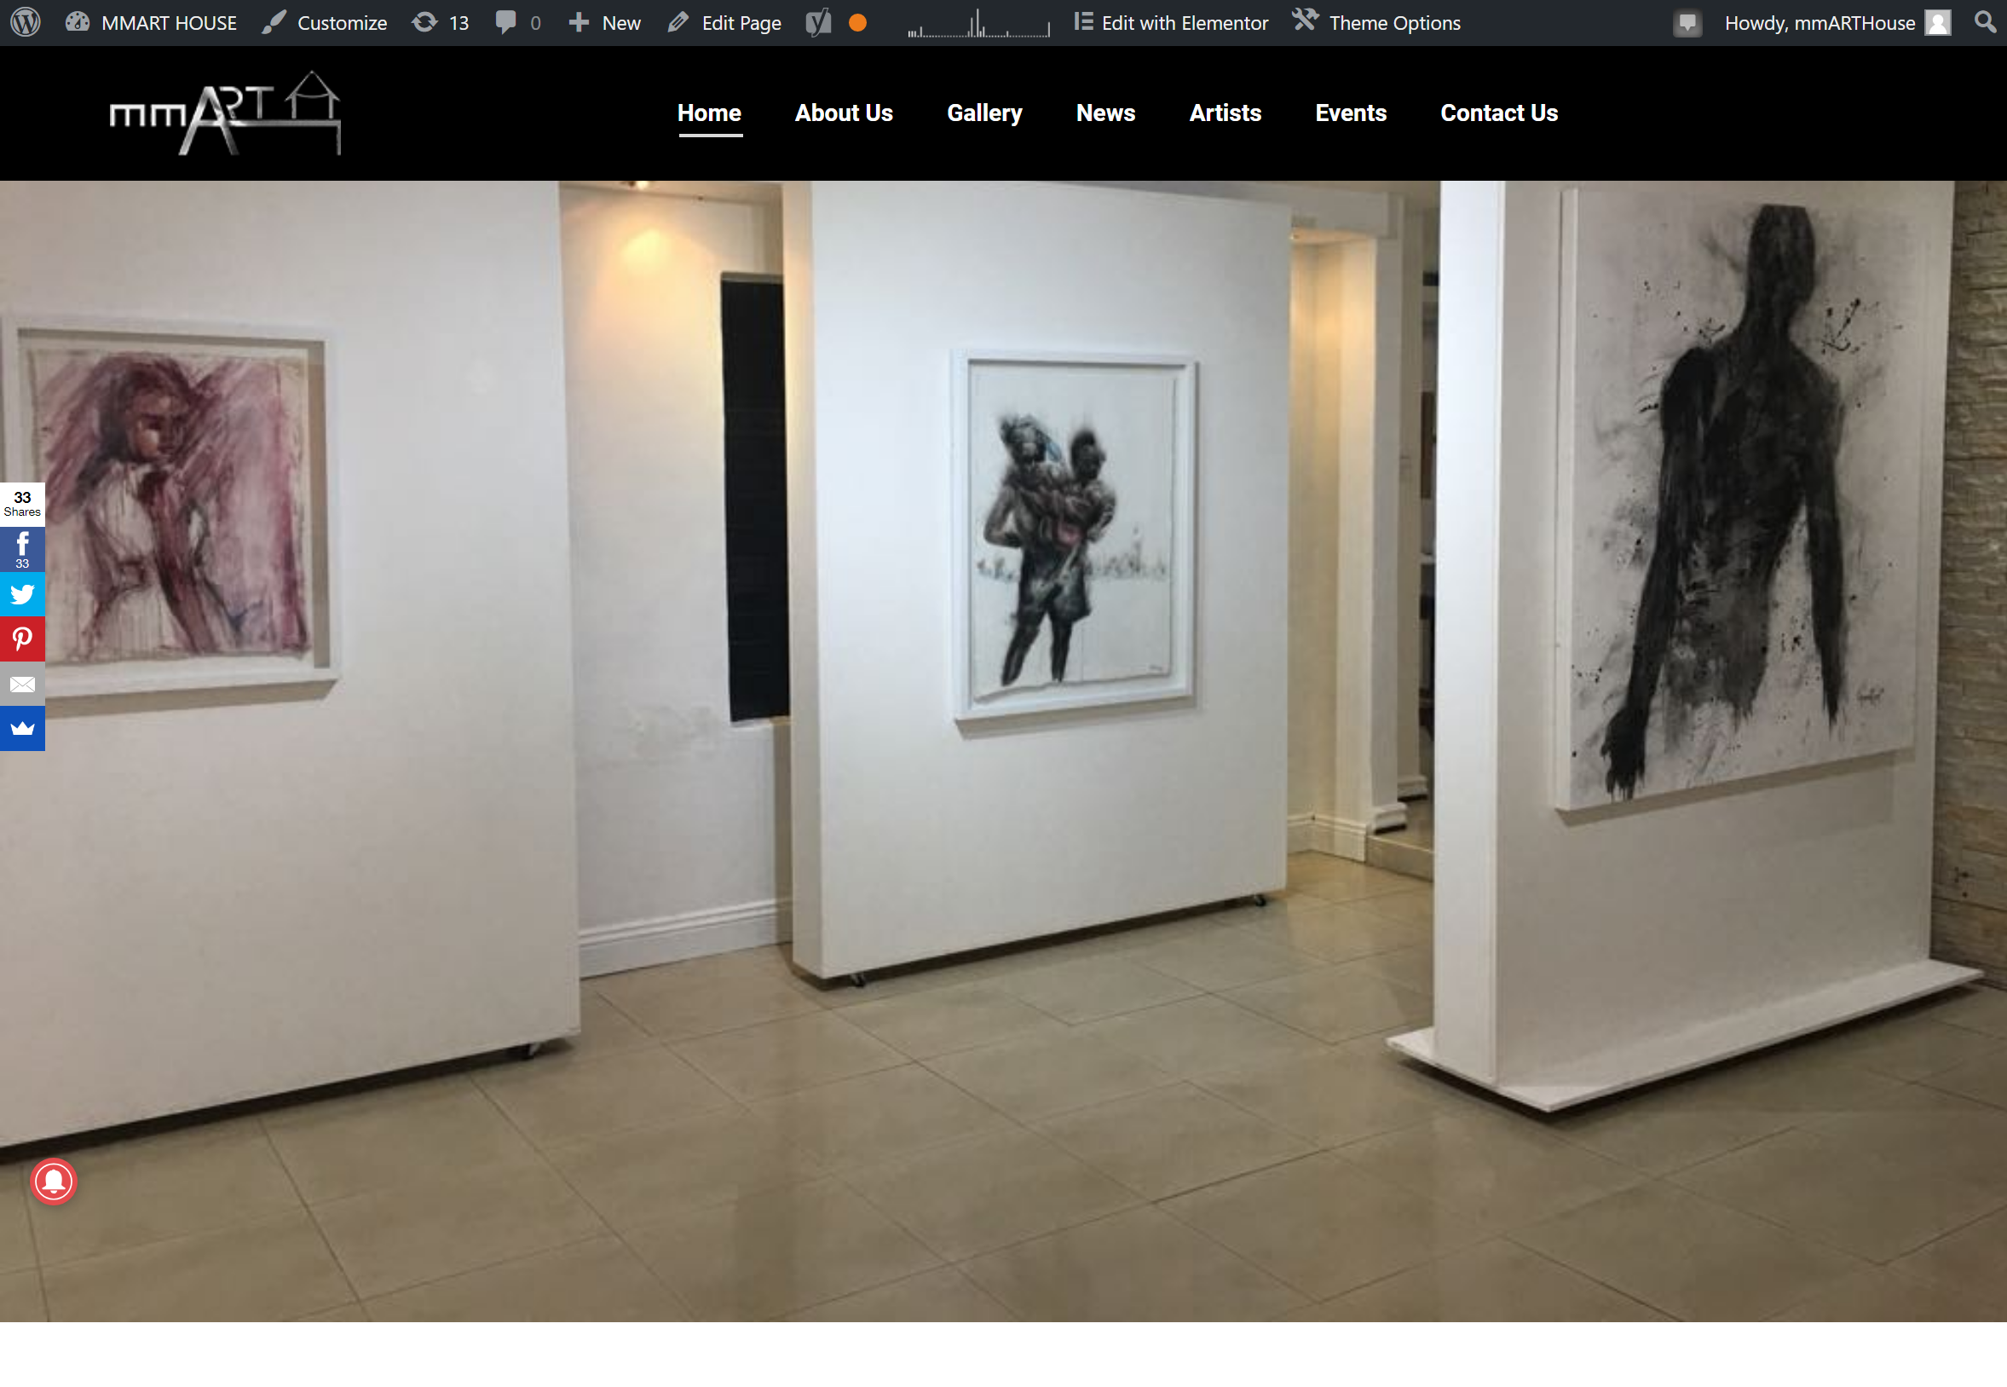
mmARTHouse
This website is created in WordPress which is a content management system.
You username is: mmARTHouse Password: &%8E@T$&#%
Please note any changes made to the website cannot be undone once saved, so if there is something you aren’t sure about please get a website developer to make changes.
This is the front-end of your website

Slide 2
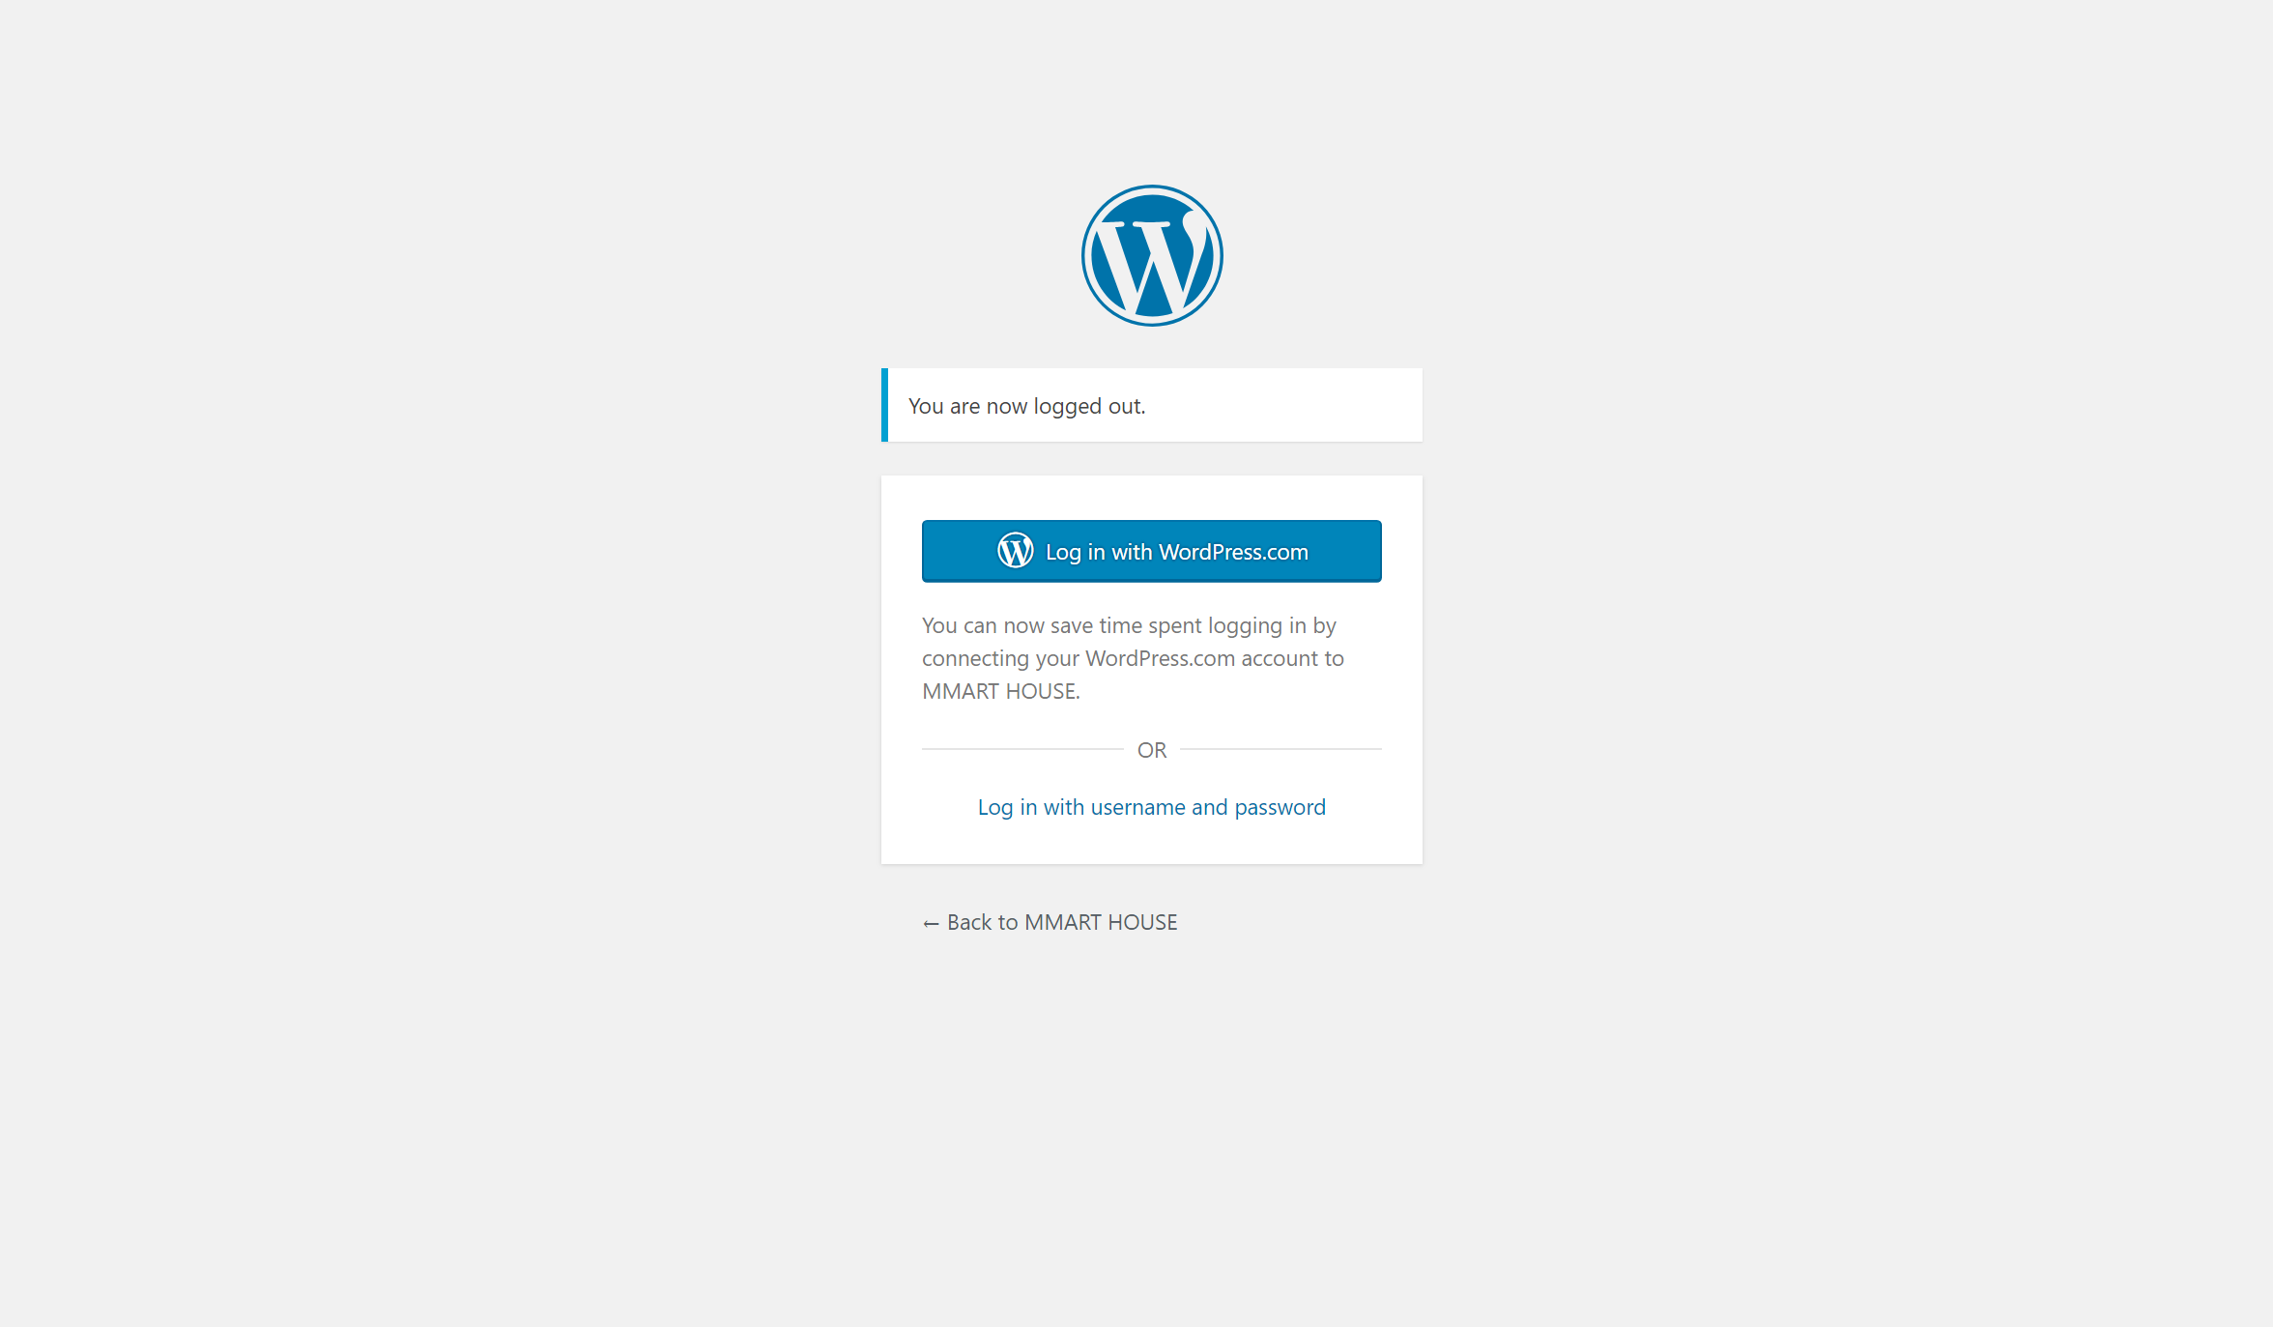
mmARTHouse
This is the back-end of your website
To access this section type in your browser
http://www.mmarthouse.co.za/wp-admin/
Enter the username and password provided to you.

Slide 3
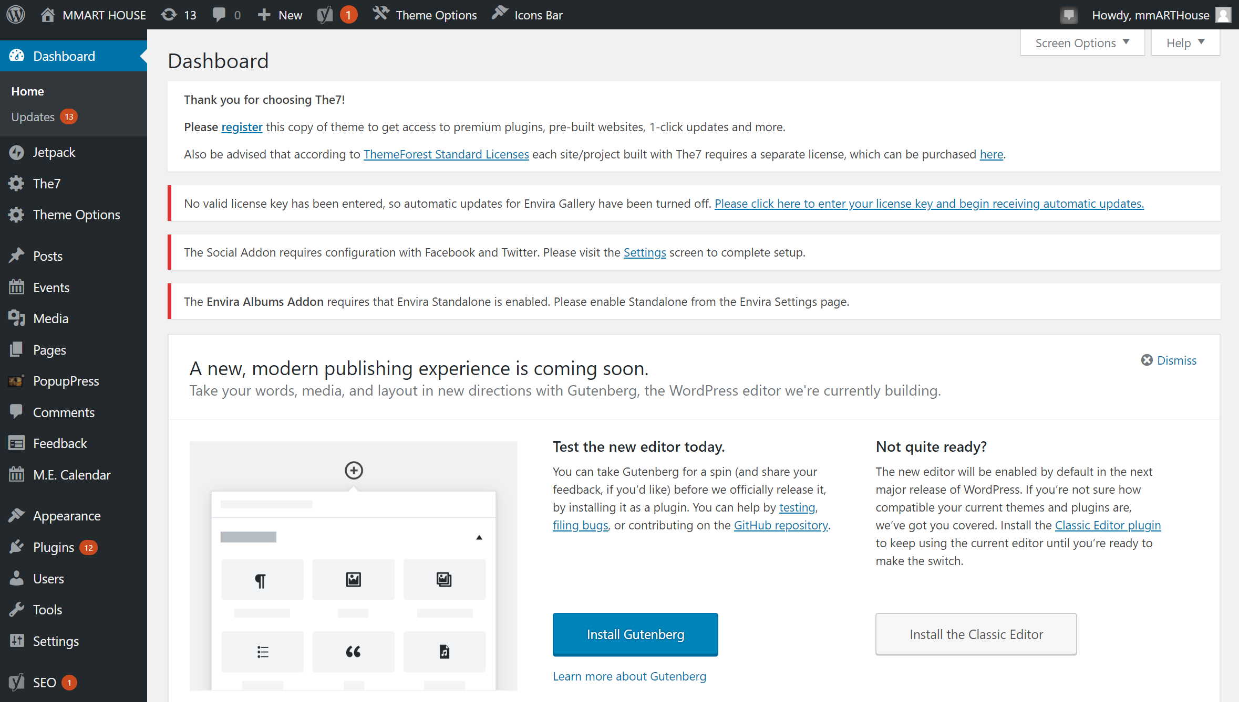
mmARTHouse
This is your dashboard
Once logged in you will see your dashboard this is where all your website content can be accessed. Each menu item is a Page, except for a News article which will be a Post

Slide 4
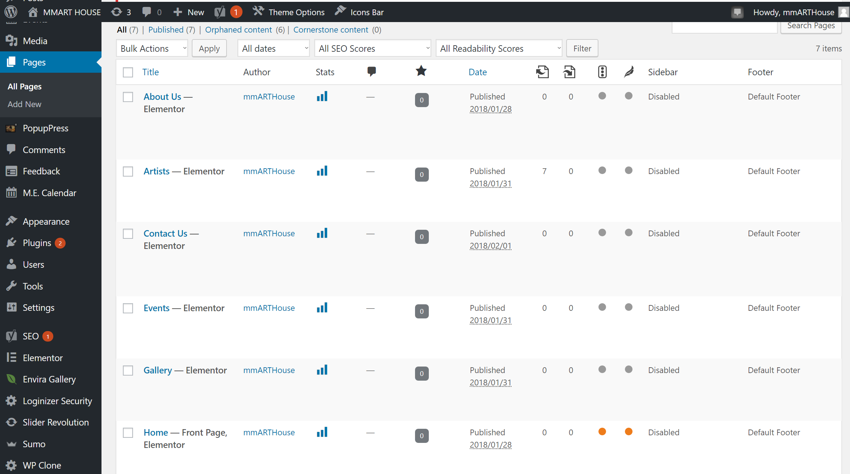
mmARTHouse
If you click on the Pages item on the left hand side you will be shown a list of all your pages/content on your website
To edit a page you can click on the title or click on the Edit item

Slide 5
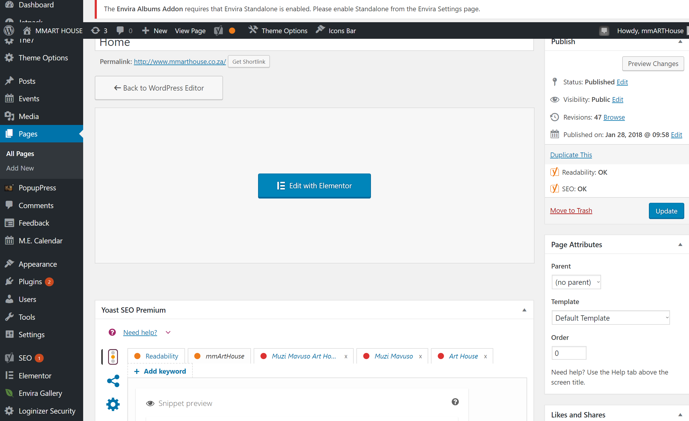
mmARTHouse
This will load your content in a new window
The website was built with Elementor Site Builder, which will edit the layout of your website.
To edit your site hover over the “Elementor” button and click the icon on the blue bar situated in that area of content

Slide 6
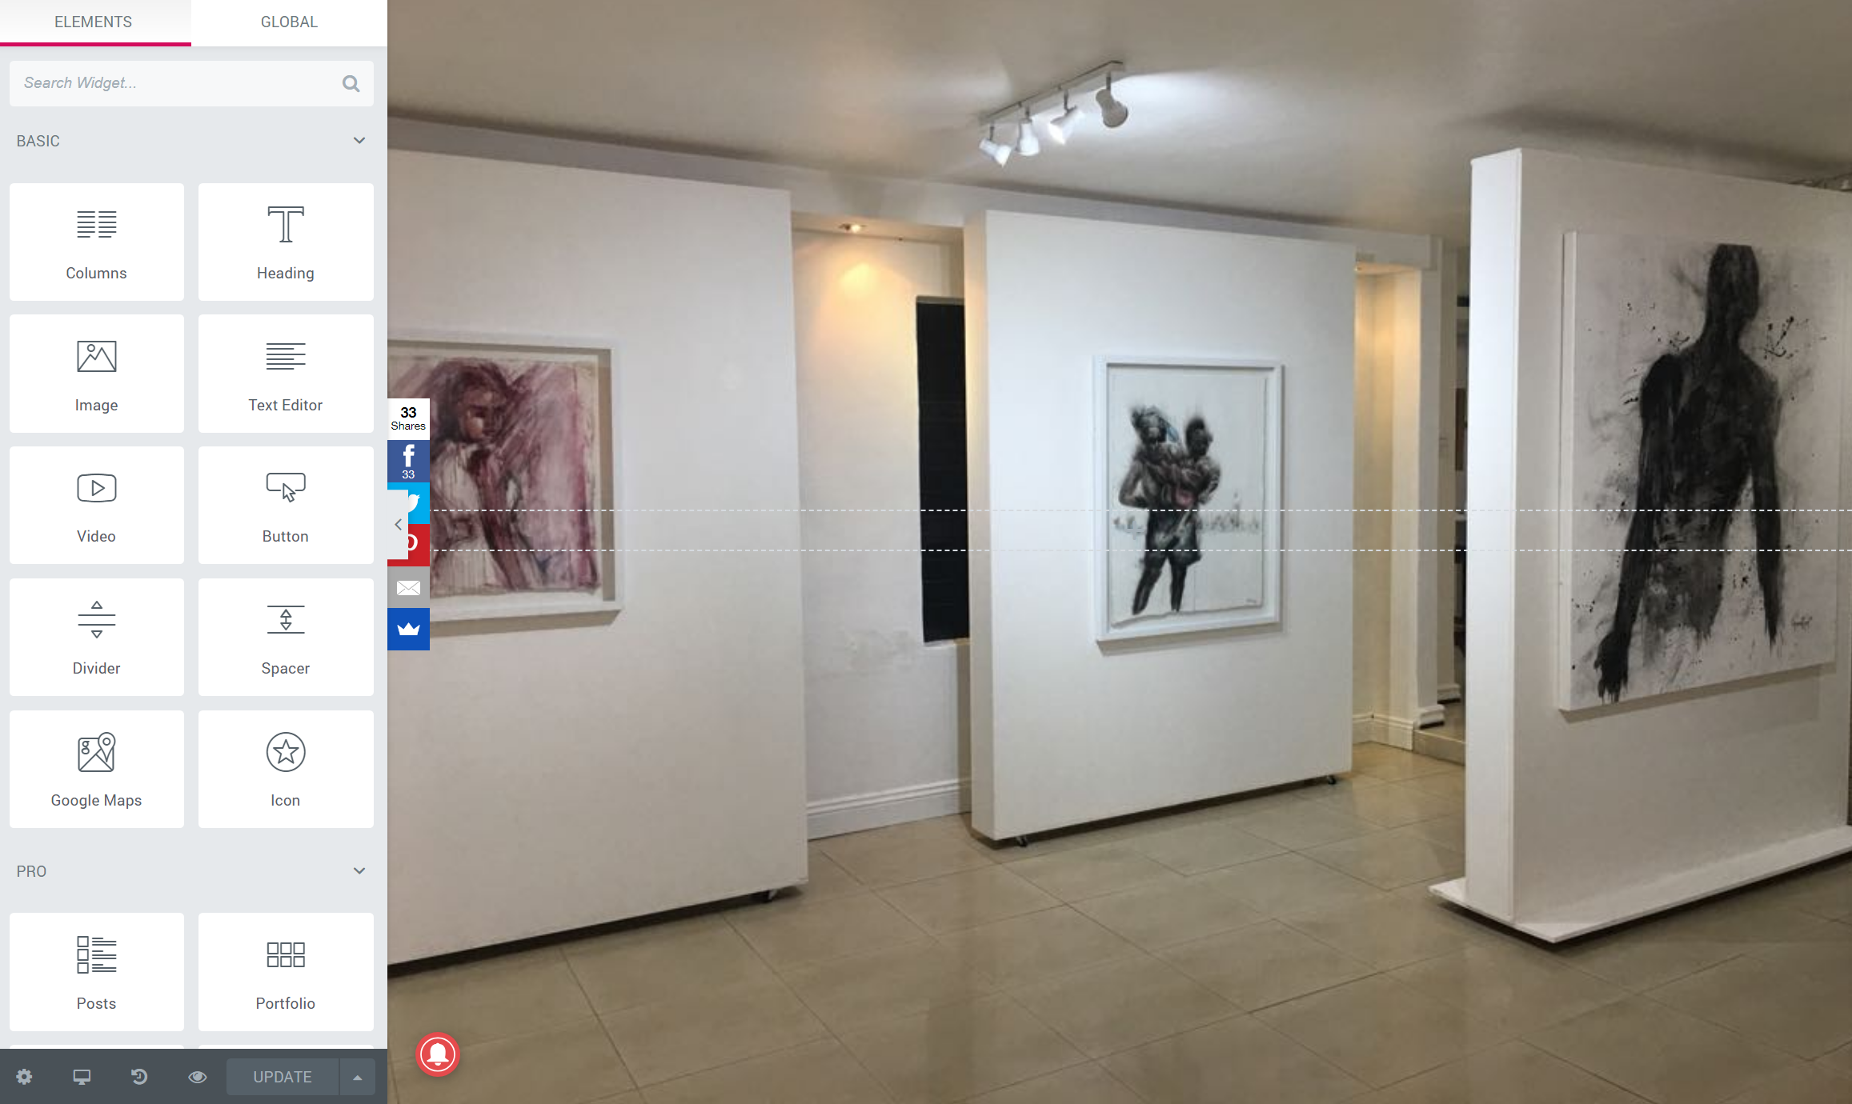
mmARTHouse
This will load your site builder
This is where the you edit the backend of your websites content, you can make the changes and click the save/update button in the bottom left corner as highlighted.
When you are happy that the changes are made
You can click the Preview Changes (eye) button.

Slide 7
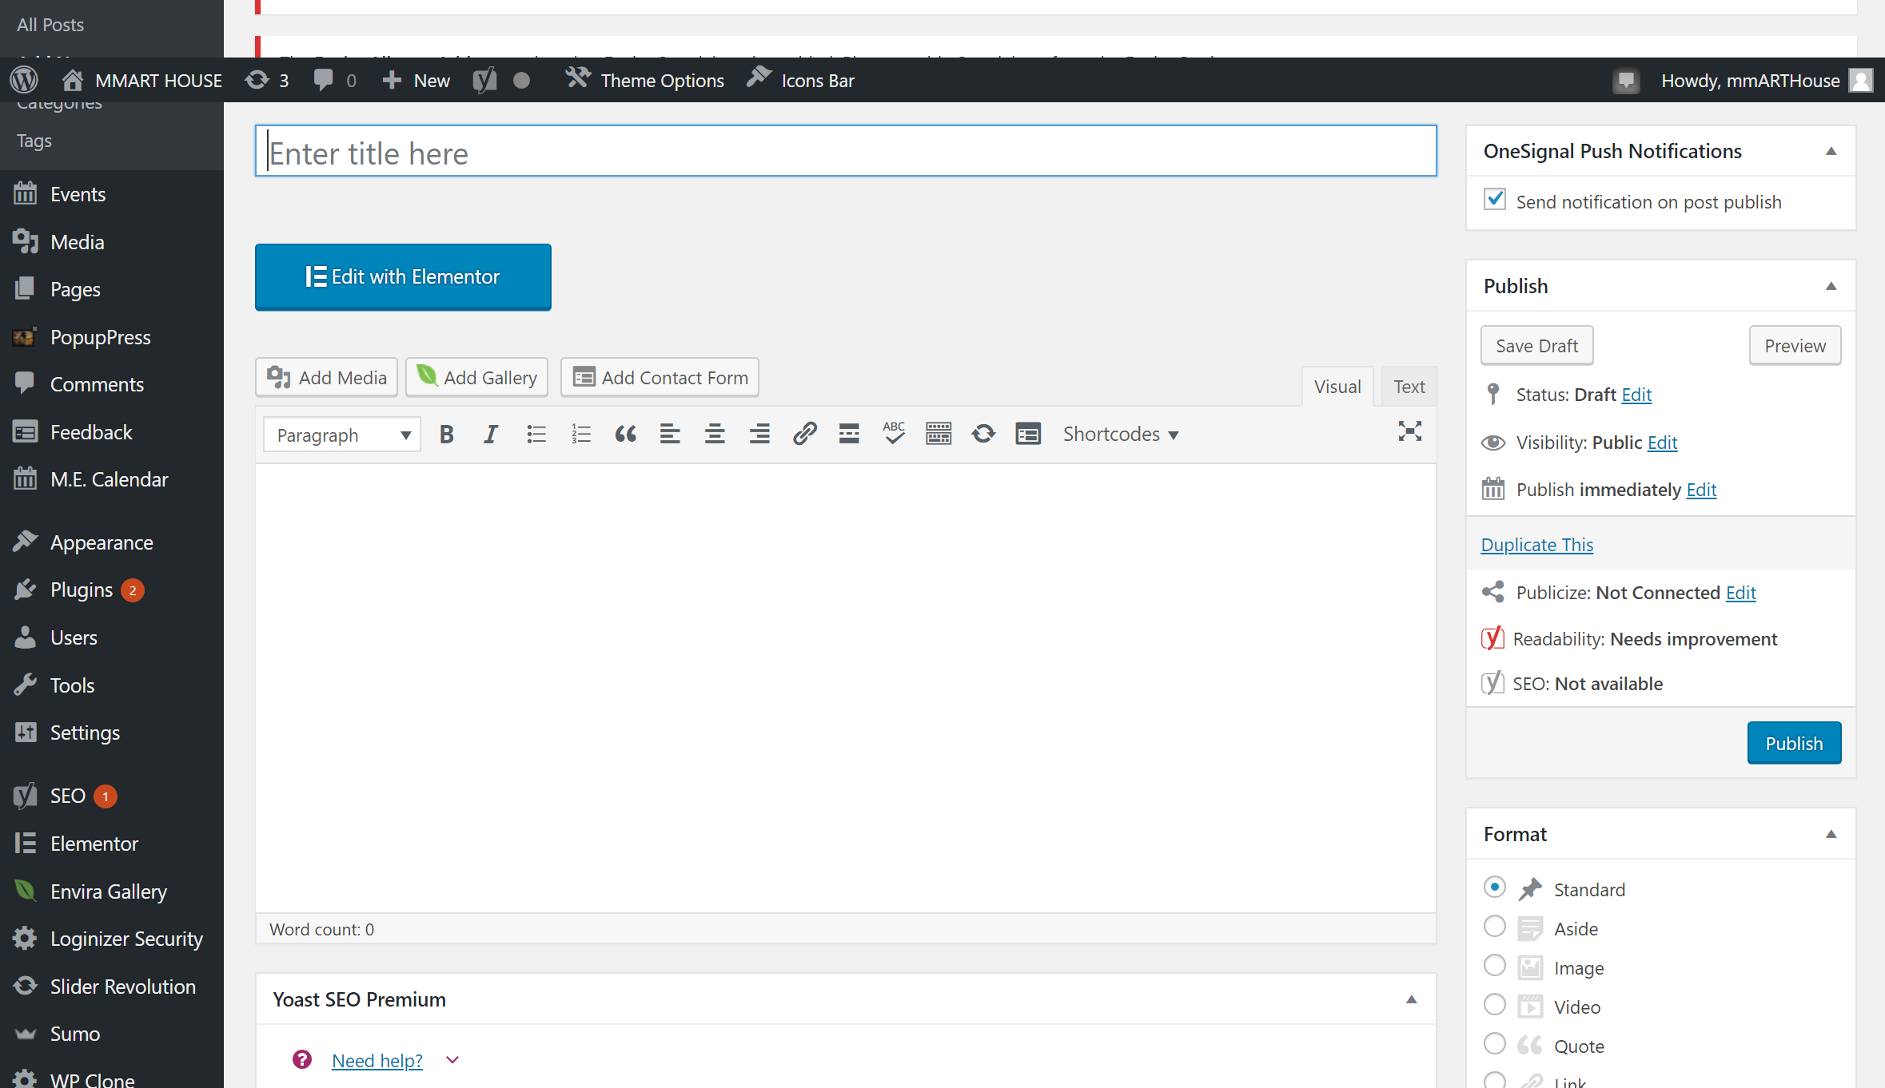
mmARTHouse
Creating a News Article / New Post
The News Articles in your site are set up as Posts / New, so to create a new post, go to the Posts section on the left hand side then click the Add New post item.
This will bring up the Post Editor, here you can add your Post Name and content.
Please remember to tick the categories News icon on the right hand side for this to show up on your News page
When you’re happy with this click the Preview button to check the post and finally the Publish button

Slide 8
mmARTHouse
When you are done
Please return to dashboard and you can logout

